Slide 1
Graph Isomorphism and Edge Graph Isomorphism
Edel Sherratt

Slide 2
Original Problem
Given some small molecules, write a program that discovers all the molecules that can be formed by breaking existing bonds and forming new bonds

Slide 3
Example

Slide 4
Approach: orderly generation
Start with a set of bonds (edges) and a set of atoms (vertices)
The set of bonds has cardinality k
Generate all the sets containing k+1 bonds that represent distinct fragments/molecules
Keep doing this until it is no longer possible to add a bond to any of the current sets

Slide 5
Recognising distinct fragments
At each step, there is a collection of sets, each containing the same number of bonds (edges)
Want to eliminate some – not all – isomorphic graphs
Isomorphic graphs sometimes represent distinct molecular fragments …

Slide 6
Isomorphs but not Isomers

Slide 7
Isomorphs and Isomers, but distinct

Slide 8
No need to test every pair of sets
Order bonds according to bond types (edge labels) and the atoms involved (vertex labels)
For example (C-C) comes before (C=C)
Potential duplicates are sets of bonds that are equivalent under this ordering
Test these for isomorphism

Slide 9
Nauty only deals with vertex labels
Nauty (McKay, 1981) is the fastest known algorithm for isomorphism testing
But Nauty only deals with simple vertex-labelled graphs
Would like simple vertex-labelled graphs that are isomorphic iff the original edge- and vertex-labelled graphs are isomorphic

Slide 10
Graph and Edge graph

Slide 11
The Edge graph
Aside: edge graph is not defined for isolated vertices

Slide 12
Difficulties
Easy to see that graph isomorphism implies edge graph isomorphism
It would be nice if edge graph isomorphism always implied graph isomorphism– but that’s not the case!
K3 and S4 graphs have isomorphic edge graphs

Slide 13
K3 and S4

Slide 14
What is actually proved
Two graphs are isomorphic iff
they have equal numbers of isolated vertices
they have equal numbers of K3 components
the edge graph corresponding to each connected component from the first graph can be paired with its isomorphic counterpart from the second

Slide 15
Proof strategy
Observe that two graphs are isomorphic iff their connected components are isomorphic
Consider connected graphs with isomorphic edge graphs

Slide 16
Consider
Connected graphs G₁ and G₂ with isomorphic edge graphs G₁ ^{ε} and G₂ ^{ε}
A bijection f_{ε} that defines the edge graph isomorphism
f_{ε} maps the edges of G₁ (that is, the vertices of G₁ ^{ε}) to the edges of G₂ (vertices of G₂ ^{ε})

Slide 17
Four cases
For every vertex a of G₁, there is a unique vertex x of G₂ such that f_{ε} maps the edges of G₁ incident on a onto all and only the edges of G₂ incident on x
As above, but the vertex of G2 is not unique
There is at least one vertex of G1 whose incident edges are mapped to edges incident on more than one vertex of G2
There is at least one vertex of G1 whose incident edges are mapped to a single vertex of G2, but f_{ε} also maps other edges of G1 onto that vertex of G2

Slide 18
Case 1
f_{ε} maps edges of G₁ incident on a single vertex of G₁ to exactly the edges of G₂ incident on a unique single vertex of G₂
Then f_{ε} determines an edge-preserving bijection between the vertices of G₁ and G₂, and so they are isomorphic

Slide 19
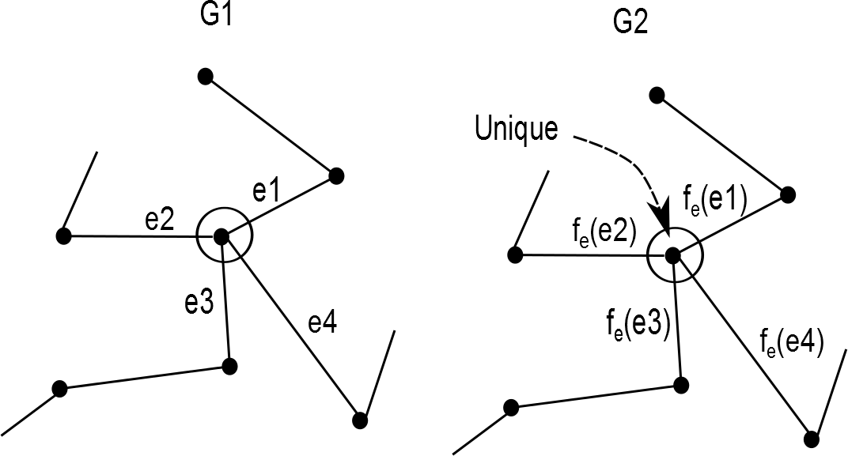
Case 1: edges incident on a single vertex of G1 map to edges incident on a unique single vertex of G2

Slide 20
Case 2
f_{ε} maps edges of G₁ incident on a single vertex of G₁ to exactly edges of G₂ incident on a single vertex of G₂, but that vertex is not unique
Then G₁ and G₂ each comprise two vertices connected by a single edge, and so the graphs are isomorphic

Slide 21
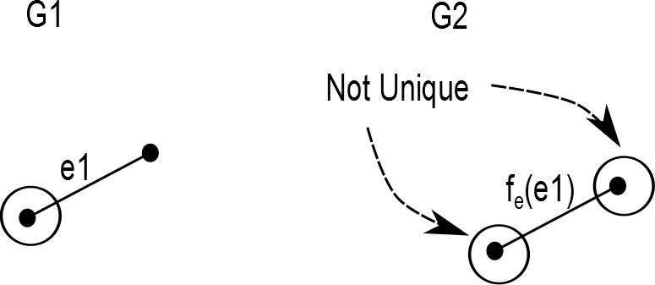
Case 2: edges incident on a single vertex of G1 map to edges incident on a single vertex of G2, but that vertex is not unique

Slide 22
Case 3
There is at least one vertex of G₁ whose incident edges are mapped by f_{ε} to a set of edges that are not incident on a single vertex of G₂
Then f_{ε} maps edges of a K₃ sub-graph of G₁ to edges of an S₄ sub-graph of G₂ or vice versa
… and the K₃ (or S₄) sub-graph of G₁ is G₁ and the S₄ (or K₃) sub-graph of G₂ is G₂

Slide 23
Case 3: edges incident on a vertex of G₁ mapped to edges that incident on more than one vertex of G₂

Slide 24
Case 4: edges incident on a single vertex G₁ mapped to edges incident on a single vertex of G₂, but other edges also mapped to that vertex

Slide 25
Summary
Transform a graph to its edge graph to facilitate isomorphism testing
Need to take account of different cases
Proof that this is ok is long-winded, but worth doing to avoid errors in software
Applied in the Abermol chemical structure generator
Some interest in the Nauty community

